Slide 1
BRICKS
Bricks are blocks of tampered clay molded to suitable shapes and sizes while it is still in plastic condition, dried in the sun and burnt if desired so as to make them more strong, hard and durable.
Dimensions of bricks are
9” x 4.5” x 3”
215 x 102.5 x 65

Slide 2
CLASSIFICATION OF BRICKS
Kacha Bricks/ Sun Dried Bricks/ Unburnt Bricks
Sun-dried or unburnt bricks are less durable and these are used for temporary structures. Unburnt bricks preparation involved in 3 steps they are preparation of clay, molding and drying.
After molding, bricks are subjected to sunlight and dried using heat from sun. So, they are not that much strong and they also have less water resistance and less fire resistance. These bricks are not suitable for permanent structures.

Slide 3
2. Burnt Clay Bricks
Burnt bricks are good quality bricks but however they also consist some defected bricks. So, burnt bricks are classified into four types and they are
First class bricks
Second class bricks
Third class bricks
Fourth class bricks

Slide 4
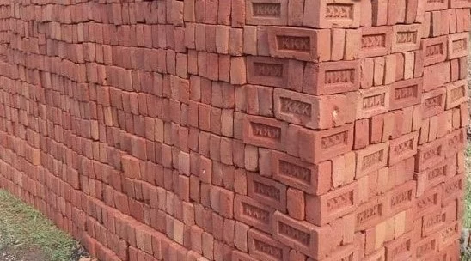
First Class Bricks
First class bricks are good quality bricks compared to other classes. They are molded by table-molding and burnt in large kilns. So, these bricks contain standard shape, sharp edges and smooth surfaces.
They are more durable and having more strength. They can be used for permanent structures. However, because of their good properties they are costly than other classes.

Slide 5
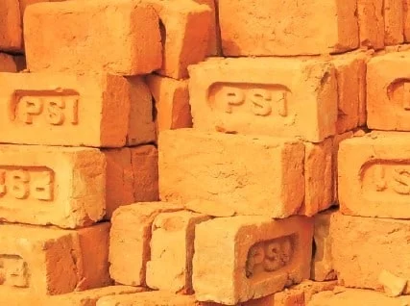
Second Class Bricks
Second class bricks are moderate quality bricks and they are molded by ground-molding process. These bricks are also burnt in kilns. But because of ground molding, they do not have smooth surfaces as well as sharp edges. The shape of bricks also irregular due to unevenness in ground.

Slide 6
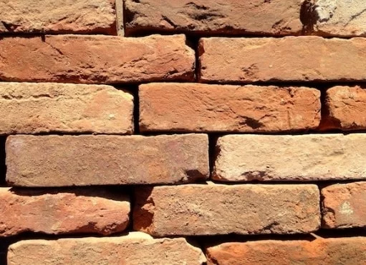
Third Class Bricks
Third class bricks are poor quality bricks which are generally used for temporary structures like unburnt bricks. These are not suitable for rainy areas. They are ground-molded type bricks. The surface of this type of bricks are rough and they have unfair edges

Slide 7
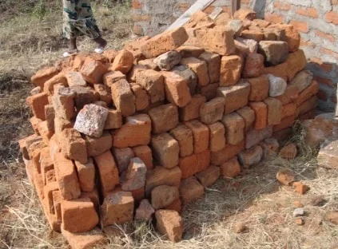
Fourth Class Bricks
Fourth class bricks are very poor quality bricks and these are not used as bricks in the structure. They are crushed and used as aggregates in the manufacturing of concrete. They are obtained by over burning, because of this they gets overheated and obtains brittle nature. So, they can break easily and not suitable for construction purpose.

Slide 8
PROPERTIES OF BRICKS
Following are the properties of bricks which represents the importance of bricks in construction. i. Hardness ii. Compressive strength iii. Absorption
Hardness of Bricks
A good quality brick will have resistance against abrasion. This property is called hardness of brick which helps to give permanent nature of brick structure. Because of this property bricks do not damaged by scraping.

Slide 9
2. Absorption of Bricks
Bricks are generally absorbs water but having limits. Absorption limit percentage by weight for different classes of bricks is tabulated below.
Class of Bricks | Water Absorption % by weight
Heavy duty bricks (special made) | Only 5%
First class | 20%
Second class | 22%
Third class | 25%

Slide 10
Compressive strength of Bricks
Compressive strength or crushing strength is the property of brick which represent the amount of load carried by brick per unit area.

Slide 11
CLASSIFICATION OF BRICKS (cont’d)
Engineering Bricks
Made carefully and from selected clay
Finished brick is very solid and hard
Capable of carrying load more than any other type of brick
Used for walls having exceptionally heavy load
Semi Engineering Bricks
Harder than ordinary brick but not as hard as engineering brick

Slide 12
BRICK EARTH
Clay suitable for making brick are composed mainly of Silica (in the forms of grains of sands) and alumina which is soft plastic part of clay which readily absorbs water and makes the clay plastic and which melt when burnt.

Slide 13
BRICK EARTH (cont’d)
A good brick earth should consist of the following composition
Clay (alumina) 20 – 30 % by weight
Smaller in size than 0.002 mm
Silt 20 -35 % by weight
Smaller than 0.075 mm and greater than 0.002 mm
Sand 35 – 50 % by weight
Smaller than 4.75 mm and greater than 0.075 mm

Slide 14
HARMFUL INGREDIENTS PRESENT IN BRICK EARTH
Pebbles/ Gravels
Makes it difficult to mix the brick earth thoroughly
Iron Pyrite
Get oxidized, and split the brick to pieces.
Alkalies
Causes the brick to melt,
Lime
Excess of lime melts the brick particles and as a result brick loses its shape.

Slide 15
Site selection for manufacturing of bricks
For the manufacturing of bricks, the site should be selected based on some important considerations such as:
The ground should be of plain surface.
The site should be connected with communicating roads for transporting materials etc.,
Good brick earth should be easily available.
The site should offer all facilities to the workers

Slide 16
Manufacturing process of bricks
Three different operations are involved in the process of manufacturing of bricks:
Molding
Drying
Burning

Slide 17
MANUFACTURE OF BRICKS FROM CLAY
Bricks
Bricks have greater fire resistance than stone or concrete masonry. Its size enables easy handling and placement in walls; it can be easily adapted to small-scale and large-scale structures to give pleasing appearance and texture
Molding of Brick
The raw material is dug from pits, crushed, ground, to reduce it to a fine constituency - Then it is tempered with water to produce a plastic clay for forming into brick

Slide 18
Drying of raw bricks
After molding process the bricks contain some amount of moisture in it. So, drying is to be done otherwise they may cracked while burning. The drying of raw bricks is done by natural process. In Some situations artificial drying is adopted under special dryers or hot gases. The period of drying may be 3 to 10 days. It also depends upon the weather conditions.

Slide 19
Burning of bricks
In the process of burning, the dried bricks are burned either in clamps (small scale) or kilns (large scale) up to certain degree temperature. In this stage, the bricks will gain hardness and strength so it is important stage in manufacturing of bricks.
The temperature required for burning is about 1100ºC. If they burnt beyond this limit they will be brittle and easy to break. If they burnt under this limit, they will not gain full strength and there is a chance to absorb moisture from the atmosphere.
Hence burning should be done properly to meet the requirements of good brick.

Slide 20
Identification of Bricks Quality at Construction Site
The color of bricks should be bright and uniform.
They should be well burned and having smooth surfaces and sharp edges.
When we struck two bricks together, ringing sound should be delivered.
Structure of bricks should be homogeneous and uniform.
The bricks should not break when we dropped it form 1m height.
There should not be any white deposits on brick, when we soaked it in water for 24 hrs.

